Slide 1

Programming in Java Exception Handling
L

Slide 2
Exception

Slide 3
Introduction
An exception is an event, which occurs during the execution of a program, that disrupts the normal flow of the program's instructions.
An exception is an abnormal condition that arises in a code sequence at run time.
A Java exception is an object that describes an exceptional (that is, error) condition that has occurred in a piece of code.
In other words, “An exception is a run-time error.”

Slide 4
Exception Handling
class Exception
{
public static void main (String arr[])
{
System.out.println(“Enter two numbers”);
Scanner s = new Scanner (System.in);
int x = s.nextInt();
int y = s.nextInt();
int z = x/y;
System.out.println(“result of division is : ” + z); }
}

Slide 5
Exception Handling
An Exception is a run-time error that can be handled programmatically in the application and does not result in abnormal program termination.
Exception handling is a mechanism that facilitates programmatic handling of run-time errors.
In java, each run-time error is represented by an object.

Slide 6
Exception (Class Hierarchy)
At the root of the class hierarchy, there is a class named ‘Throwable’ which represents the basic features of run-time errors.
There are two non-abstract sub-classes of Throwable.
Exception : can be handled
Error : can’t be handled
RuntimeException is the sub-class of Exception.
Each exception is a run-time error but all run-time errors are not exceptions.

Slide 7
Throwable
Exception Error
RunTimeException - VirtualMachine
IOException - ArithmeticException - NoSuchMethod
SQLException - ArrayIndexOutOf - StackOverFlow
BoundsException
- NullPointerException
Checked Exception
Unchecked Exception

Slide 8
Commonly used sub-classes of Exception
ArithmeticException
ArrayIndexOutOfBoundsException
NumberFormatException
NullPointerException
IOException

Slide 9
Commonly used sub-classes of Errors
VirualMachineError
StackOverFlowError
NoClassDefFoundError
NoSuchMethodError

Slide 10
Uncaught Exceptions
class Exception_Demo
{
public static void main(String args[])
{
int d = 0;
int a = 42 / d;
}
}
When the Java run-time system detects the attempt to divide by zero, it constructs a new exception object and then throws this exception.
once an exception has been thrown, it must be caught by an exception handler and dealt with immediately.

Slide 11
Why Exception Handling?
When the default exception handler is provided by the Java run-time system , why Exception Handling?
Exception Handling is needed because:
it allows to fix the error, customize the message .
it prevents the program from automatically terminating

Slide 12
Exception Handling

Slide 13
Keywords for Exception Handling
try
catch
throw
finally

Slide 14
Keywords for Exception Handling
try
used to execute the statements whose execution may result in an exception.
try {
Statements whose execution may cause an exception
}
Note: try block is always used either with catch or finally or with both.

Slide 15
Keywords for Exception Handling
catch
catch is used to define a handler.
It contains statements that are to be executed when the exception represented by the catch block is generated.
If program executes normally, then the statements of catch block will not executed.
If no catch block is found in program, exception is caught by JVM and program is terminated.

Slide 16
class Divide{
public static void main(String arr[]){
try {
int a= Integer.parseInt(arr[0]);
int b= Integer.parseInt(arr[1]);
int c = a/b;
System.out.println(“Result is: ”+c);
}
catch (ArithmeticException e)
{System.out.println(“Second number must be non-zero”);}
catch (NumberFormatException n)
{System.out.println(“Arguments must be Numeric”);}
catch (ArrayIndexOutOfBoundsException a)
{System.out.println(“Invalid Number of arguments”);}
}
}

Slide 17
Nested Try’s
class NestedTryDemo {
public static void main(String args[]){
try {
int a = Integer.parseInt(args[0]);
try {
int b = Integer.parseInt(args[1]);
System.out.println(a/b);
}
catch (ArithmeticException e)
{
System.out.println(“Div by zero error!");
}
}
catch (ArrayIndexOutOfBoundsException) {
System.out.println(“Need 2 parameters!");
}
}}

Slide 18
Defining Generalized Exception Handler
A generalized exception handler is one that can handle the exceptions of all types.
If a class has a generalized as well as specific exception handler, then the generalized exception handler must be the last one.

Slide 19
class Divide{
public static void main(String arr[]){
try {
int a= Integer.parseInt(arr[0]);
int b= Integer.parseInt(arr[1]);
int c = a/b;
System.out.println(“Result is: ”+c);
}
catch (Throwable e)
{
System.out.println(e);
}
}
}

Slide 20
Keywords for Exception Handling
throw
used for explicit exception throwing.
throw(Exception obj);
‘throw’ keyword can be used:
to throw user defined exception
to customize the message to be displayed by predefined exceptions
to re-throw a caught exception
Note: System-generated exceptions are automatically thrown by the Java run-time system.

Slide 21
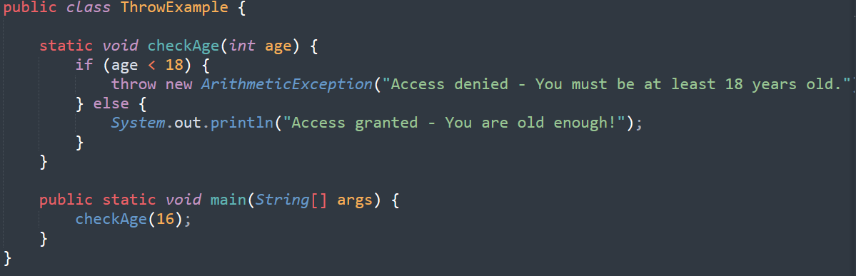

Slide 22
class ThrowDemo
{
static void demo()
{
try {
throw new NullPointerException("demo");
}
catch(NullPointerException e)
{
System.out.println("Caught inside demo.");
throw e; // rethrow the exception
}
}
public static void main(String args[])
{
try {
demo();
}
catch(NullPointerException e)
{
System.out.println("Recaught: " + e);
}
}
}

Slide 23
Keywords for Exception Handling
throws
A throws clause lists the types of exceptions that a method might throw.
type method-name(parameter-list) throws exception-list
{
// body of method
}
This is necessary for all exceptions, except those of type Error or Runtime Exception, or any of their subclasses.
All other exceptions that a method can throw must be declared in the throws clause. If they are not, a compile-time error will result.

Slide 24
Propagation of Exceptions
If an exception is not caught and handled where it is thrown, the control is passed to the method that has invoked the method where the exception was thrown.
The propagation continues until the exception is caught, or the control passes to the main method, which terminates the program and produces an error message.

Slide 25
Propagation of Exceptions
class ExceptionPropagation{
public void first() { int data=50/0; }
public void second(){ first(); }
public void third() { try{ second(); }
catch(Exception e){ System.out.println(“Done");}
}
public static void main(String [] rk){
ExceptionPropagation ob = new ExceptionPropagation();
ob.third();
System.out.println(“Thank You");
}
}

Slide 26
Multi-catch
try{
x = Integer.parseInt(rk[0]);
y = Integer.parseInt(rk[1]);
}
catch(ArrayIndexOutOfBoundsException | NumberFormatException ae)
{
if( ae instanceof NumberFormatException)
{
System.out.println("Enter the Integers");
ae = new ArithmeticException();
}
else if( ae instanceof ArrayIndexOutOfBoundsException)
System.out.println("Enter Two Integers");
}

Slide 27
Keywords for Exception Handling
Finally
finally creates a block of code that will be executed after a try/catch block has completed and before the code following the try/catch block.
The finally block will execute whether or not an exception is thrown.
If an exception is thrown, the finally block will execute even if no catch statement matches the exception.

Slide 28
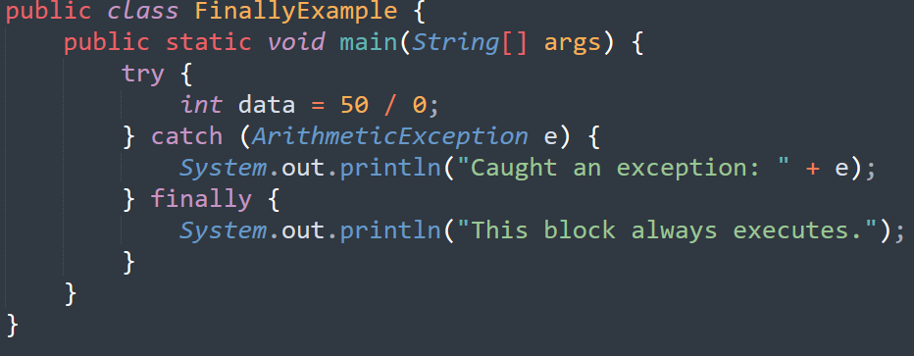

Slide 29


